Slide 1
CS595 Mid-term Presentation: Smart Contract Fuzzers Evaluation
Yuanzhou Yang, Yuezhi Che
10/18/2020

Slide 2
Fuzzers selection
Open Source Fuzzers
ContractFuzzer
Echidna
ILF
ChainFuzz
solfuzz
Symbolic execution baseline
Oyente

Slide 3
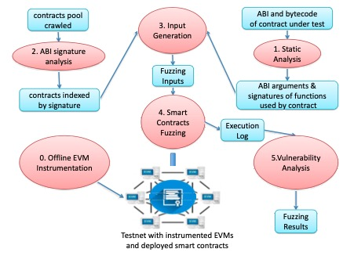
ContractFuzzer
Generate Fuzzing inputs
Analyze ABI
Smart Contracts Fuzzing
Vulnerability Analysis

Slide 4
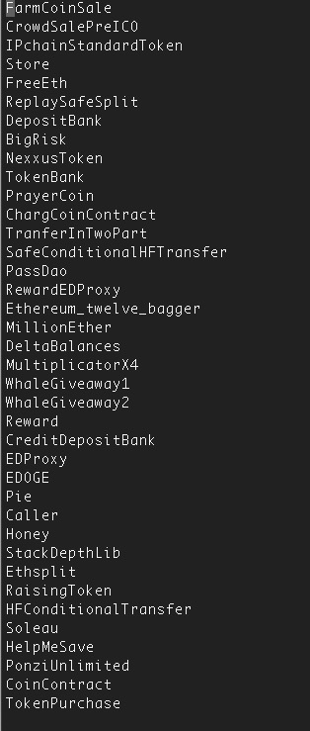
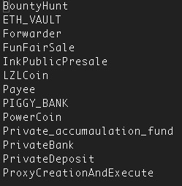
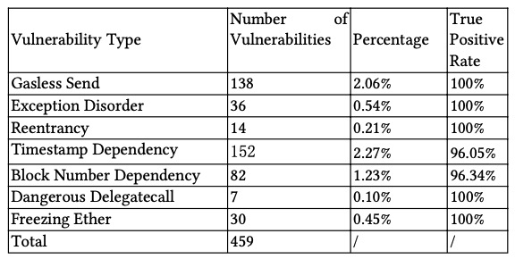
ContractFuzzer
Examples:
Gasless Send
Exception Disorder
Reentrancy
Timestamp dependency
Block number dependency
Dangerours Delegatecall
Freezing Ether
Reentrancy list
Exception disorder list

Slide 5
ILF
A tool combine symbolic execution and fuzzing.
Using imitation learning method to combine them.
Can generate high quality inputs in a very short time.
Have better performance in code coverage and vulnerabilities detection than other symbolic execution and fuzzing tools.

Slide 6
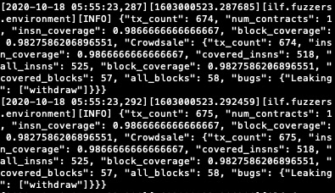
ILF
Input
Smart contract written in Solidity.
Output
Time
Transaction count
Code coverage
Vulnerability type

Slide 7
Echidna
Not relying on fixed pre-defined bug oracles to detect vulnerabilities.
Support three types properties:
User-defined properties
Assertion checking
Gas use estimation

Slide 8
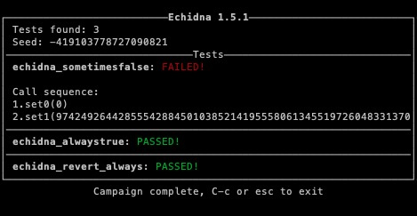
Echidna
Input
Smart contract written in Solidity.
Output:
Function test result.
Call sequence while function failed.
Code coverage?

Slide 9

ChainFuzz
Successfully installed on VM.
No instruction on how to run.

Slide 10
solfuzz
Has been deprecated & its functionality has been integrated into to the Sabre CLI.

Slide 11
Oyente
One of the earliest symbolic execution tool (2016).
Have introduce several new security problems.

Slide 12
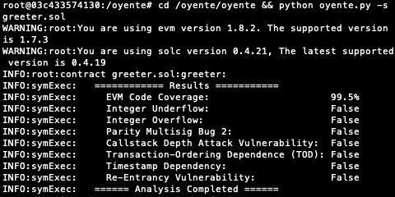
Oyente
Input
Smart contract written in Solidity.
Output
Code coverage
Vulnerability type

Slide 13
How to compare the result
Most of the tools have no output of time.
All tool have the vulnerabilities type except echidna.
Only ILF and oyente have code coverage.

Slide 14
References
Luu, Loi, et al. "Making smart contracts smarter." Proceedings of the 2016 ACM SIGSAC conference on computer and communications security. 2016.
Jiang, Bo, Ye Liu, and W. K. Chan. "Contractfuzzer: Fuzzing smart contracts for vulnerability detection." 2018 33rd IEEE/ACM International Conference on Automated Software Engineering (ASE). IEEE, 2018.
He, Jingxuan, et al. "Learning to fuzz from symbolic execution with application to smart contracts." Proceedings of the 2019 ACM SIGSAC Conference on Computer and Communications Security. 2019.
Grieco, Gustavo, et al. "Echidna: effective, usable, and fast fuzzing for smart contracts." Proceedings of the 29th ACM SIGSOFT International Symposium on Software Testing and Analysis. 2020.
ContractFuzzer: https://github.com/gongbell/ContractFuzzer
ChainFuzz： https://github.com/ChainSecurity/ChainFuzz
Solfuzz: https://github.com/b-mueller/solfuzz

Slide 15
Thank you!

